Slide 1

AN style guide for object oriented design
Luis Ruiz pavón
@luisruizpavon
Github.com/lurumad

Slide 2
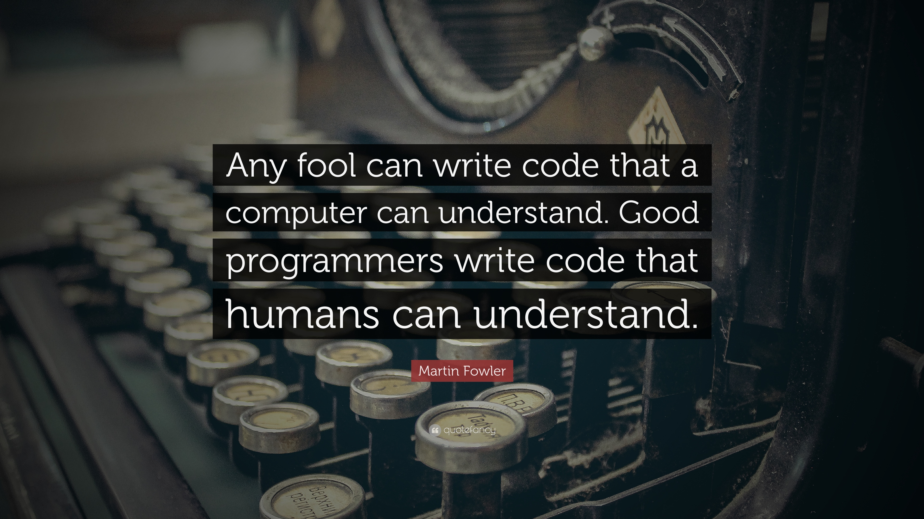

Slide 3
OBJECT Types
Objects that hold data and expose methods to manipuate it.
Entities (Mutable objects - Identifier equality)
Value Objects (Inmutable objects that wraps primitives – Values equlity)
Services perform task and retrieve data.
Used entities and value objects to complete their tasks.
Notes:
Las entidades son objetos mutables son iguales si sus Ids son iguales, 2 usuarios son iguales si su Id es el mismo, 2 facturas son iguales si su Id es el mismo.
Por el contrario, los values objects son objetos inmutables que se caracterizan por envolver tipos primitivos y que se diferencian de otro objeto por su valor no por su identidad.

Slide 4

Creating Entities & value objects
Luis Ruiz pavón

Slide 5
Require the minimum amount of data needed to behave consistently
public class Position
{
const float EarthRadiusInKilometers = 6378.0F;
public float Latitude { get; set; }
public float Longitude { get; set; }
public float DistanceInKilometersTo(Position position)
{
/// Haversine formula
}
}
0
var granada = new Position();
var madrid = new Position();
var kilometers = granada.DistanceInKilometersTo(madrid);

Slide 6
Require the minimum amount of data needed to behave consistently
public class Position
{
public Position(float latitude, float longitude)
{
Latitude = latitude;
Longitude = longitude;
}
public float Latitude { get; }
public float Longitude { get; }
}
var granada = new Position(latitude: 37.176487F, longitude: -3.597929F);
var madrid = new Position(latitude: 40.4168f, longitude: -3.70379f);
var kilometers = granada.DistanceInKilometersTo(madrid);

Slide 7

Invariants enforcement is the responsibility of the entities
public class Position
{
public Position(float latitude, float longitude)
{
Latitude = latitude;
Longitude = longitude;
}
public float Latitude { get; }
public float Longitude { get; }
}
var = new Position(latitude: 1000, longitude: -4000);

Slide 8
Invariants enforcement is the responsibility of the entities
public Position(float latitude, float longitude)
{
if (latitude < -90 || latitude > 90)
{
throw new ArgumentException("Latitude should be between -90 and 90");
}
if (longitude < -180 || longitude > 180)
{
throw new ArgumentException("Longitude should be between -180 and 180");
}
Latitude = latitude;
Longitude = longitude;
}
var nonsense = new Position(latitude: 1000, longitude: -4000);

Slide 9
Invariants enforcement is the responsibility of the entities (Guard Clauses)
public Position(float latitude, float longitude)
{
Ensure.Argument.Is(latitude >= -90 && latitude <= 90, "Latitude should be …");
Ensure.Argument.Is(longitude >= -180 && longitude <= 180, “Longitude should be …");
Latitude = latitude;
Longitude = longitude;
}

Slide 10
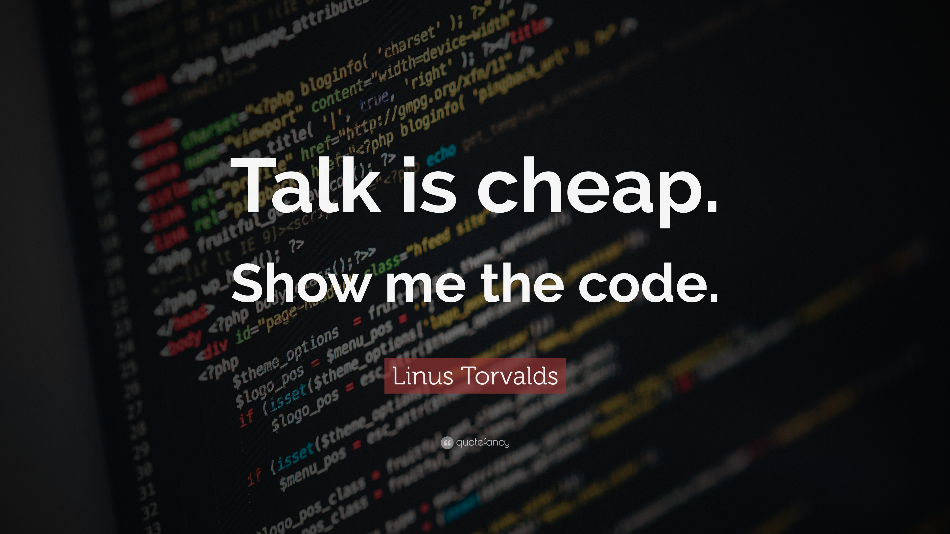

Slide 11
Do not use custom exceptions for invalid argument exceptions
public Position(float latitude, float longitude)
{
if (latitude < -90 || latitude > 90)
{
throw new InvalidLatitudeException();
}
if (longitude < -180 || longitude > 180)
{
throw new InvalidLongitudeException();
}
Latitude = latitude;
Longitude = longitude;
}
Notes:
Un argumento inválido significa que el objeto se está usando de una manera incorrecta. Normalmente esto ocurre por algún fallo de programación y en este caso es mejor fallar, no vamos a hacer ningún mecanismo de recuperación. Además de esto, podemos generar un gran número de excepciones personalizadas que nos van a introducir más ruido y trabajo en nuestra aplicación.

Slide 12
Do not use custom exceptions for invalid argument exceptions
[Fact]
public void not_allow_longitude_could_be_greater_than_180()
{
Action position = () => new Position(latitude: -100, longitude: 240);
position.Should().Throw<InvalidLatitudeException>();
}

Slide 14
Dealing with primitive obsession
Smell for use primitives instead of small objects for simple tasks (such as currency, special strings for phone numbers, emails, etc.)
Notes:
Es un Smell que se produce cuando uno utiliza tipos primitivos como Strings o Doubles o Ints para representar conceptos que realmente deberían ser representados por clases de objetos.
Inmutable objects that wraps primitives
But there are special rules for email. This logic is typically captured somewhere away from the “Email” value, and typically duplicated throughout the application. For some reason, I was averse to creating small objects to hold these values and their simple logic. I don’t really know why, as data objects tend to be highly cohesive and can cut down a lot of duplication.

Slide 15
Dealing with primitive obsession
public Position(float latitude, float longitude)
{
Ensure.Argument.Is(latitude >= -90 && latitude <= 90, "Latitude should be between -90 and 90");
Ensure.Argument.Is(longitude >= -180 && longitude <= 180, "Longitude should be between -90 and 90");
Latitude = latitude;
Longitude = longitude;
}
public float Latitude { get; }
public float Longitude { get; }
Notes:
Existen una serie de reglas especiales para la la latitude y la logitud. Esta logica solemos ponerla repartida por nuestra aplicación lo que conyeva duplicaciónd e Código o crearnos la magnifica clase Helper dond etodo vale,e sa clase de 40000 línea sde Código que como su nombre es un comodín y todo ayuda pues Adelante.

Slide 17
Dealing with primitive obsession
Latitude latitude = new Latitude(56); // constructor
Latitude latitude = (Latitude)56; // explicit operator
float lat = latitude; // implicit operator
Console.WriteLine(“Latitude: {0}", latitude); // ToString method

Slide 18
Dealing with primitive obsession
How do we know when we could replace Primitive with Object?
Would any string, int, etc be acceptable here?
If the answer is NO, replace Primitive with Object.

Slide 19
Extract new object to represent composite values
public class Share
{
public void SetPrice(Amount amount, Currency currency)
{
}
}
public class MoneyConverter
{
public Amount Convert(Amount amount, Currency from, Currency to)
{
}
}

Slide 20
Extract new object to represent composite values
public class Money
{
private readonly Amount amount;
private readonly Currency currency;
public Money(Amount amount, Currency currency)
{
Ensure.Argument.NotNull(amount, nameof(amount));
Ensure.Argument.NotNull(currency, nameof(currency));
this.amount = amount;
this.currency = currency;
}
public static Money From(decimal amount, string code)
{
return new Money(Amount.FromScalar(amount), Currency.FromCode(code));
}
}

Slide 22
Named constructors
public class Colour
{
private byte red;
private byte green;
private byte blue;
public Colour(byte red, byte green, byte blue)
{
this.red = red;
this.green = green;
this.blue = blue;
}
}
new Colour(0, 255, 0) /// RGB
new Colour(0, 100, 50) /// HSL
new Colour("#ffffff") /// Hexadecimal
new Colour("#fff") /// Short Hexadecimal
Notes:
Los “named constructors” o métodos factoria como también son conocidos nos permiten que nuestros constructores sean más semánticos, mas cercano al negocio y mas alejado de lo puramente técnico.
Hue, Saturation, Lightness – Matiz, Saturación, Luminosidad
What happen when the langues not Support method overloading?

Slide 24
Named constructors
public class Reservation
{
private Reservation()
{
}
public static Reservation Make()
{
return new Reservation();
}
}
var reservation = Reservation.Make();
Notes:
Optionally use the private constructor to enforcé constraints .
Hacer una reserva

Slide 25
Named constructors
public class Order
{
private Order()
{
}
public static Order Place()
{
return new Order();
}
}
var order = Order.Place();
Notes:
Me gustaría hacer un pedido…

Slide 26
Only test the constructor for ways in which it should fail
public class Position
{
public float Latitude { get; set; }
public float Longitude { get; set; }
public Position(float latitude, float longitude)
{
Ensure.Argument.Is(latitude >= -90 && latitude <= 90, "Latitude should be …");
Ensure.Argument.Is(longitude >= -180 && longitude <= 180, “Longitude should be …");
Latitude = latitude;
Longitude = longitude;
}
}

Slide 27
Only test the constructor for ways in which it should fail
public class position_should
{
[Fact]
public void allow_create_a_valid_position()
{
var position = new Position(12, -40);
position.Latitude.Should().Be(12);
position.Longitude.Should().Be(-40);
}
}
Notes:
But now we’ve introduced a way for internal data to get out of the object, for no other reason than to test the constructor. This meaning the test is very close to the implementation of the class

Slide 28
Only test the constructor for ways in which it should fail
public class position_should
{
[Fact]
public void not_allow_longitude_could_be_greater_than_180()
{
Action sut = () => new Position(latitude: 15, longitude: -240);
sut.Should().Throw<ArgumentException>().WithMessage(CoreStrings.InvalidLongitude);
}
}

Slide 29
Track Changes & Record events
public class Order
{
public OrderId Id { get; private set; }
public OrderStatus Status { get; private set; }
private Order(OrderId Id)
{
OrderId = id;
Status = OrderStatus.Open;
}
public static Order Place(OrderId Id)
{
return new Order(id);
}
public void Cancel()
{
Ensure.That<DomainException>(status.id != OrderStatus.Canceled.id, "The order was already cancelled.");
status = OrderStatus.Canceled;
}
}
Notes:
An entity may change over time, but all this time it should be the same object that undergoes all the changes.That’s why an entity needs to be identifiable. When creating it we give it an identifier.
This identifier can be used by the entity’s repository to save the object. Later on we can use that same identifier to retrieve it from the repository, after which it can be modified again.
Given that the state of an entity changes over time, entities are mutable objects. They come with specific rules for their implementation. The methods that change the entity’s state should have a void return type and their names should be in the imperative form

Slide 30
Track Changes & Record events
public class order_should
{
[Fact]
public void allow_to_be_cancel()
{
var order = Order.Place(new OrderId());
order.Cancel();
order.Status.Should().BeEquivalentTo(OrderStatus.Canceled);
}
}
Notes:
But now we’ve introduced a way for internal data to get out of the object, for no other reason than to test the status has changed.

Slide 31
Track Changes & Record events
public class Order
{
private OrderId id;
private OrderStatus status;
private readonly List<IEvent> events = new List<IEvent>();
public IReadOnlyCollection<IEvent> Events => events;
private Order(OrderId Id)
{
this.id = id;
status = OrderStatus.Open;
events.Add(OrderOpened.Create());
}
public static Order Place(OrderId Id)
{
return new Order(id);
}
public void Cancel()
{
Ensure.That<DomainException>(status.id != OrderStatus.Canceled.id, "The order was already cancelled.");
status = OrderStatus.Canceled;
events.Add(OrderCancelled.Create());
}
}

Slide 32
Track Changes & Record events
public class order_should
{
[Fact]
public void allow_to_be_cancel()
{
var order = Order.Place(new OrderId());
order.Cancel();
order.Events.Last.Should().OfType<OrderCancelled>();
}
}
Notes:
But now we’ve introduced a way for internal data to get out of the object, for no other reason than to test the status has changed.

Slide 33
Track Changes & Record events
public class order_should
{
[Fact]
public void allow_to_be_cancelled()
{
var order = Order.Place();
order.Cancel();
order.Events.Should().HaveCount(2);
order.Events.ElementAt(0).Should().BeOfType<OrderOpened>();
order.Events.ElementAt(1).Should().BeOfType<OrderCancelled>();
}
}

Slide 34

Using Entities & value objects
Luis Ruiz pavón

Slide 35
Template for methods
[scope] [return-type] methodName(Type name, ...)
{
[pre-condition checks]
[failure scenarios]
[happy path]
[post-condition checks]
[return void|specific-return-type]
}
Notes:
Una vez que hemos instanciado un objeto ya estamos listo para usarlo. Los objetos suelen tener comportamientos: nos pueden dar información, pueden ejecutar una tarea por nosotros… Estos comportamientos se implementarán a través de métodos. Antes de entrar a discutir sobre como recuperamos la información o ejecutamos tareas vamos a discutir primero algo que los métodos deben tener en común: "Una plantilla para su implementación"

Slide 36
Template for methods (PRE-CONDITION CHECKS)
if ([/* some pre-condition wasn't met */)
{
throw new ArgumentException(...);
}
Notes:
El primer paso será verificar que los argumentos que nos provee el cliente son válidos y que podemos usarlos para completar la tarea. Haz todos los chequeos que sean necesarios y lanza las excepciones que sean necesarias.

Slide 37
Template for methods (failure scenarios)
public async Task ConfirmUser(Email email)
{
var user = await db.Users.GetBy(email);
if (user is null)
{
throw new KeyNotFoundException($"User with email({email}) was not found.");
}
///...
}
Notes:
Incluso cuando hemos pasado las pre-condiciones las cosas pueden ir mal. Por ejemplo en el caso del email, puede ser que el email sea válido pero cuando vamos a las base de datos a buscar un usuario por ese email puede ser que no exista. En este caso deberíamos lanzar otro tipo de excepción (Recuerda que para caso de pre-condiciones normalmente utilizamos excepciones del framework) personalizada que indica que no se trata de un error por argumentos inválidos. Estos tipos de excepciones indican que ha ocurrido un error por algún tipo de condición que puede ser manejado en tiempo de ejecución:

Slide 38
Return Early
public async Task ConfirmUser(Email email)
{
var user = await db.Users.GetBy(email);
if (user != null)
{
....
if (...)
{
}
....
}
throw new KeyNotFoundException($"User with email({email}) was not found.");
}

Slide 39
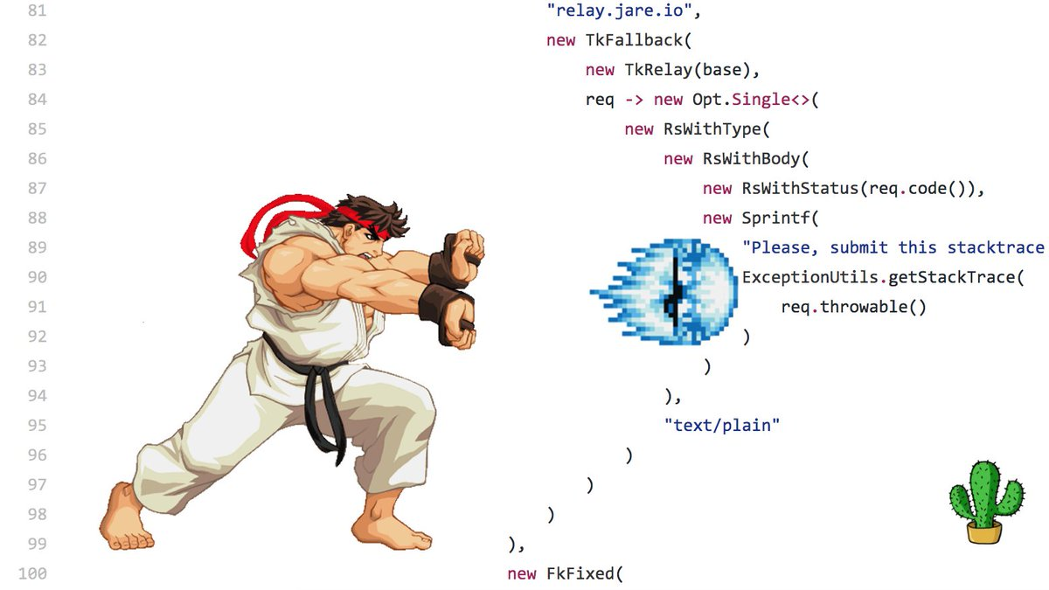

Slide 40
Return Early (GUARD CLAUSES)
public async Task ConfirmUser(Email email)
{
var user = await db.Users.GetBy(email);
Ensure.IsNotNull<KeyNotFoundException>(user, ($"User with email({email}) was not found.");
///...
}

Slide 41
Rules for custom exceptions: Catch Root errors messages
AddProblemDetails(configure =>
{
configure.IncludeExceptionDetails = _ => environment.IsDevelopment();
configure.Map<KeyNotFoundException>(exception =>
{
return new ProblemDetails()
{
Status = StatusCodes.Status404NotFound,
Type = Constants.HttpStatuses.NotFound,
Detail = exception.Message
};
});
})

Slide 42
Rules for custom exceptions: named constructors
public class CouldNotFind : Exception
{
private CouldNotFind(string message) : base(message)
{
}
public static CouldNotFind ProductWith(int id)
{
return new CouldNotFind($"Could not find a product with ID ({id})");
}
}

Slide 43
Rules for custom exceptions: named constructors
public class ProductService
{
public Product GetBy(int id)
{
var product = db.Products.Find(id);
if (product is null)
{
throw CouldNotFind.ProductWith(id);
}
}
}

Slide 44
Rules for custom exceptions: multiple ways to instantiate them
public class CouldNotCheckoutProcess : Exception
{
private CouldNotCheckoutProcess(string message) : base(message)
{
}
public static CouldNotCheckoutProcess DueToProductHasAMinimumQuantityRequiredTOrder()
{
return new CouldNotCheckoutProcess($"Could not ...");
}
public static CouldNotCheckoutProcess DueToProductIsOnlyAvailableToPreRegistered()
{
return new CouldNotCheckoutProcess($"Could not ...");
}
}

Slide 45
Retrieving information: Mutable objects
public class Counter
{
public int CurrentCount { get; private set;
public void Increment()
{
CurrentCount++;
}
}
Notes:
Anteriormente hemos visto los métodos de tipo comando. Se caracterizan por no retornar un valor (void) y cambiar el estado (mutar). Este tipo de métodos no debería n usarse para recuperar información. Si quieres recuperar información de un objeto deberías crear un método para tal propósito. En el caso de lenguajes de C# tenemos las propiedades automaticas que es un tipo de azúcar sintactico que en ocasiones nos ahorra tener que crea getters/setters. Estos tipos de métodos tiene un tipo de retorno específico y no se les permite producir cambios en el estado del objeto.

Slide 46
Retrieving information: InMutable objects
public class Counter
{
public int CurrentCount { get; private set; }
public Counter Incremented()
{
var copy = (Counter)MemberwiseClone();
copy.CurrentCount++;
return copy;
}
}
Notes:
Como podemos observar el método Increment (imperativo) ha sido renombrado para denotar que lo que hace es devolver un contador incrementado.

Slide 47
Avoid to exposing internal state to the clients
public class Basket
{
private Dictionary<string, Item> _items = new Dictionary<string, Item>();
public IReadOnlyCollection<Item> Items => _items.Select(x => x.Value).ToList();
}
basket.Items.Count

Slide 48
Avoid to exposing internal state to the clients
public class Basket
{
private Dictionary<string, Item> _items = new Dictionary<string, Item>();
public int ItemsCount()
{
return _items.Values.Count;
}
}
basket.ItemsCount()
Notes:
Aquí el naming es bastante importante. No usamos el nombre CountItems() porque ese nombre suena a comando diciendole al objeto que debe hacer. En su lugar lo llamamos ItemsCount() que hace que el recuento de elementos es un aspecto del carrito de la compra del que solo a través de él puedes averiguar su valor.

Slide 49
TELL DON’T ASK
public class OrdersService
{
public async Task CancelBy(int id)
{
var order = await orderRepository.GetBy(id);
if (order.Status.Id == OrderStatus.Canceled.Id)
{
throw new DomainException("The order was previously cancelled.");
}
order.Cancel();
}
}
Notes:
Tell-Don't-Ask is a principle that reminds us that rather than asking an object for data and acting on that data, we should instead tell an object what to do. This encourages to move behavior into an object to go with the data.

Slide 50
TELL DON’T ASK
public class Order
{
public void Cancel()
{
Ensure.That<DomainException>(status.id != OrderStatus.Canceled.Id, "The order...");
status = OrderStatus.Canceled;
events.Add(OrderCancelled.Create());
}
}
Notes:
Tell-Don't-Ask is a principle that reminds us that rather than asking an object for data and acting on that data, we should instead tell an object what to do. This encourages to move behavior into an object to go with the data.

Slide 51
TELL DON’T ASK
public class OrdersService
{
public async Task CancelBy(int id)
{
var order = await orderRepository.GetBy(id);
Ensure.IsNotNull<DomainException>(order, "Could not find the order.");
order.Cancel();
}
}

Slide 52

Services
Luis Ruiz pavón

Slide 53
Constructor injection
public class FileLogger : ILogger
{
private readonly Formatter formatter;
private readonly string filePath;
public FileLogger(
Formatter formatter,
string filePath)
{
this.formatter = formatter;
this.filePath = filePath;
}
public void Log(string message)
{
var formattedMessage = formatter.Format(message);
/// ...
File.WriteAllText(filePath, formattedMessage);
}
}
Notes:
Making every dependency available as a constructor argument will make the service ready for use immediately after instantiation. No further setup will be required,and no mistakes can be made with that.
Sometimes a service needs some configuration values, like a location for storing files, or credentials for connecting to an external service. Inject such configuration values as constructor arguments too

Slide 54
Constructor injection
public class FileLogger : ILogger
{
private readonly Formatter formatter;
private readonly string filePath;
public FileLogger(
Formatter formatter = null,
string filePath = "/mnt/c/logs")
{
this.formatter = formatter;
this.filePath = filePath;
}
public void Log(string message)
{
if (formatter != null)
{
message = formatter.Format(message);
}
File.WriteAllText(filePath, message);
}
}
Notes:
El problema de esto es que complicamos el código de la clase FileLogger porque cada vez que queramos hacer uso del formatter debemos comprobar si no es nulo, de lo contrario recibiremos un maravilloso NulReferenceException. Para evitar este tipo de solución alternativa para las dependencias opcionales, cada dependencia debe ser requerida.

Slide 55
Constructor injection
public FileLogger(
Formatter formatter = null,
string filePath = null)
{
this.formatter = formatter;
this.filePath = filePath;
}
public void Log(string message)
{
var formattedMessage = formatter.Format(message);
/// ...
File.WriteAllText(filePath ?? "/mnt/c/logs", formattedMessage);
}
Notes:
En el caso de valores de configuración es lo mismo. no queda claro en qué archivo se escribirán los mensajes. La situación empeora si el valor predeterminado se oculta dentro del código.

Slide 56
Constructor injection
public class FileLogger : ILogger
{
private readonly string filePath;
public FileLogger(string filePath)
{
this.filePath = filePath;
}
public Formatter Formatter { get; set; }
}
Notes:
"No existe una dependencia opcional". Necesitas la dependencia o no
Este tipo de inyección viola 2 reglas:
No debería ser posible crear un objeto con un estado incompleto.
Los servicios deberían ser inmutables o lo que es lo mismo imposible de cambiar una vez que han sido creados.
Para evitar dependencias opcionales podemos usar lo que se conoce como patrón NullObject.

Slide 57
Constructor injection (NULL OBJECT PATTERN)
public class NullFormatter : IFormatter
{
public string Format(string message)
{
return message;
}
}
var logger = new FileLogger(new NullFormatter());
logger.Log('My message');

Slide 58
Inject what you need, not where you can get it from
public class FromToToggle: IToggle
{
public async Task<bool> IsActiveAsync(IFeatureContext context)
{
var featureStore = context.ServiceProvider.GetService<IFeatureStore>();
var fromValue = (string)await featureStore
.GetToggleParameterValueAsync<FromToToggle>(
context.ApplicationName,
context.FeatureName,
From);
var toValue = (string)await featureStore
.GetToggleParameterValueAsync<FromToToggle>(
context.ApplicationName,
context.FeatureName,
To);
///...
}
}

Slide 59
Inject what you need, not where you can get it from
public class FromToToggle : IToggle
{
private readonly IFeatureStore _featureStore;
public FromToToggle(IFeatureStore featureStore)
{
_featureStore = featureStore ?? throw new ArgumentNullException(nameof(featureStore));
}
public async Task<bool> IsActiveAsync(string applicationName, string featureName)
{
}
}

Slide 60


